Slide 2
Just the Basics:
Navigating the JustGrants System for DOJ Proposals and Awards
Sarah Marcotte – Preaward Grants and Contracts Manager, SOHE
Annie Studer – Grants & Contracts Specialist, Proposals RSP

Slide 3
Agenda
Accessing the JustGrants system
Review of roles
Preparing a Proposal
Submitting Progress Reports
Resources and templates

Slide 4
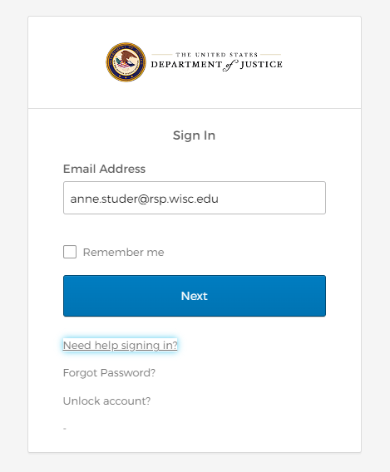
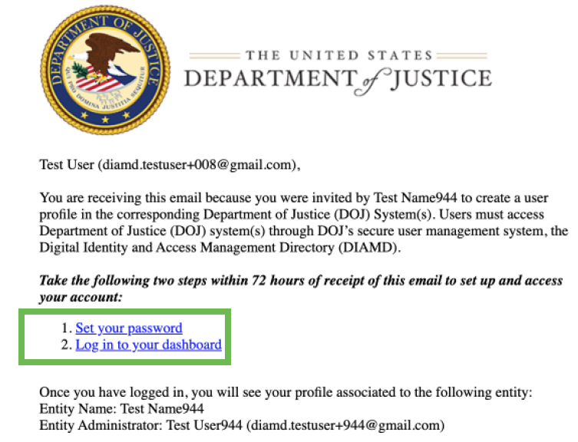
JustGrants Login
Upon receipt of a welcome email, Users have 3 days to complete this process after receiving the invitation email. After the time has elapsed, the service desk should be contacted to restart the process.
Your service desk contact information will be contained in the Welcome email (invitation).
Follow steps to complete account.
Once account is complete you will land on a "My Apps" page, click the tile that corresponds to the current application in process. This will take you to your next steps....
** The above shows what the sign-in page will look like when coming back to complete an application in progress
Notes:
Darlene Holte is UW-Madison’s entity administrator. She creates new accounts for faculty and staff needing to access JustGrants.
Email Darlene to request a new user access. Once she sets up a user’s account, you’ll receive a welcome email and you have 3 days to respond to that to complete you account set up.

Slide 5
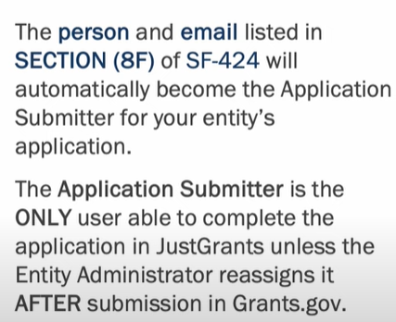
JustGrants Contacts/Role
Darlene Holte – Entity Administrator (does not count towards applicant totals) - Not to be added as the 8F point of contact
  Provides JustGrants access to applications
  Brenda Egan – Authorized Official Representative
  PI – Application Submitter
  Department RA – Application Submitter "2"
  RSP specialist – Application Submitter "3"
No more than the 4 listed above can be added
(i.e. there cannot be an "application submitter #4")
Notes:
24 hours if not associated the application

Slide 6
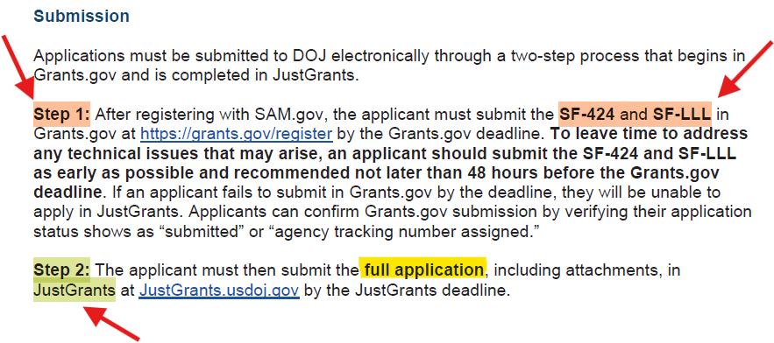
Preparing a Proposal
Two-Step Process: Pre-submission (Step 1) ---> Full submission (Step 2)
Notes:
Submit grants.gov application as early as possible
Agency will “release” a JustGrants application upon receipt of grants.gov application
**WE ARE ALREADY REGISTERED IN SAM.GOV
Applicant is the institution NOT the person

Slide 7
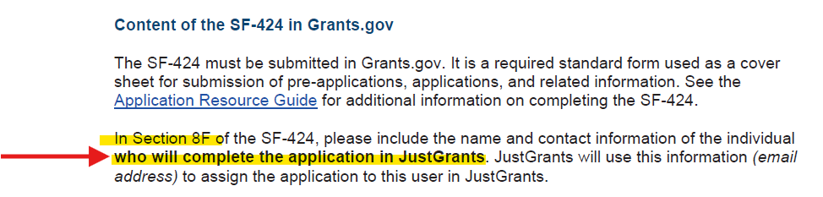
Step 1 ---> grants.gov
PI or Department Admin in Box 8F → Request RSP assign Submitter role to anyone else who needs access
Research Admin or PI has Submitter role but RSP must submit!
Notes:
8F in RAMP SF424/Cayuse = Department Research Admin or PI depending on your school/dept either the PI or dept admin can be placed in 8F however, additional folks must be requested access by Darlene Holte

Slide 8
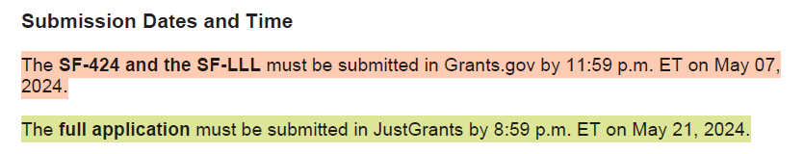
Step 1---> grants.gov submission
Follow RFP for pre-submission instructions – Step 1 Submission (Cayuse or RAMP S2S to grants.gov)
  Title, budget amount can be changed at Step 2
  RSP is not expecting a final budget at Step 1 stage
  Step 1 RAMP records will be withdrawn for copy (or new record) for Step 2
14 days between
Step 1 / Step 2

Slide 9
Step 2 Proposal ---> JustGrants
Data Requested with the Application
Abstract
Proposal Narrative
Goals, Objectives, and Deliverables
CVs
Project Management and Timeline
Letters of Support
Research and Evaluation Independence
Bibliography
Tools/Instruments/Questionnaires
List of Individuals in the Application
Request to Use Incentives or Stipends
Consortium/Contractual Arrangements
Data Archiving Plan
Documentation of New Investigator Status
Budget & Budget Justification
NICRA
Human Subjects IRB Assurance
Privacy Certificate
Other items that are likely N/A: Executive Compensation, Duplication in Costs, Pre-Agreement Costs, Limitation on Employee Compensation

Slide 10
Step 2 Proposal ---> JustGrants
Data Requested with the Application
Abstract
Proposal Narrative
Goals, Objectives, and Deliverables
CVs
Project Management and Timeline
Letters of Support
Research and Evaluation Independence
Bibliography
Tools/Instruments/Questionnaires
List of Individuals in the Application
Request to Use Incentives or Stipends
Consortium/Contractual Arrangements
Data Archiving Plan
Documentation of New Investigator Status
Budget & Budget Justification
NICRA
Human Subjects IRB Assurance
Privacy Certificate
Other items that are likely N/A: Executive Compensation, Duplication in Costs, Pre-Agreement Costs, Limitation on Employee Compensation

Slide 11
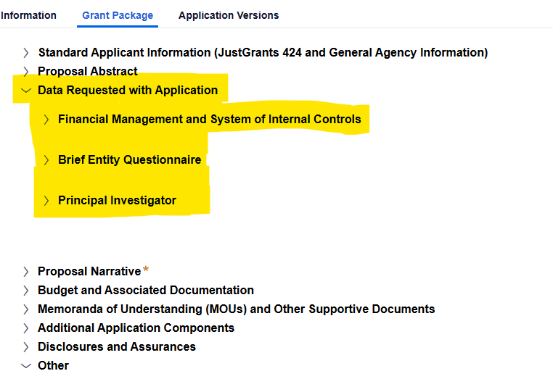
Data Requested with Application
RSP is responsible for completing these items within the JustGrants application.
It is recommended to be reviewed by department in case there are project specific questions.
Each NOFO can have different requirements, so reviewing NOFO is of utmost importance.
These items do NOT need to be completed before routing to RSP.
Notes:
This is an example from one application. Other NOFOs may specify different information in this section.
Read the NOFO carefully!

Slide 12
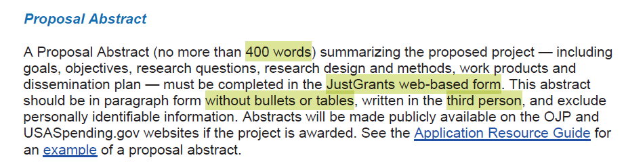
Abstract
Enter onto web form
400 characters or less
Will be made publicly available
Use 3rd person

Slide 13
Goals, Objectives, and Deliverables
Entered in Proposal Narrative Form
Goal Statement (255 characters max)
Objective (255 characters max per objective)
  Enter fiscal year and quarter
Deliverables
  Select from picklist
  Enter fiscal year and quarter
Notes:
Suggest PI enter this info onto a template

Slide 14
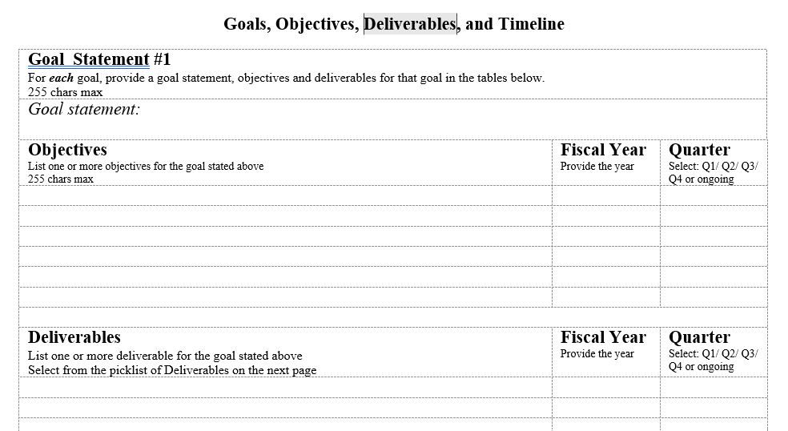
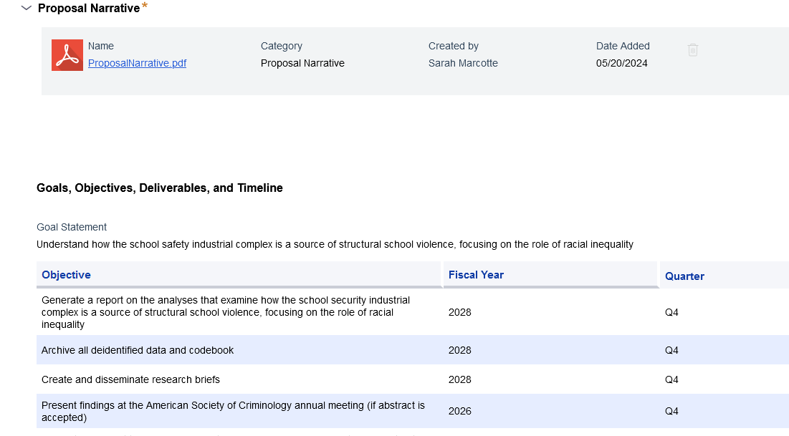
Goals, Objectives, and Deliverables
Web form
Template

Slide 15
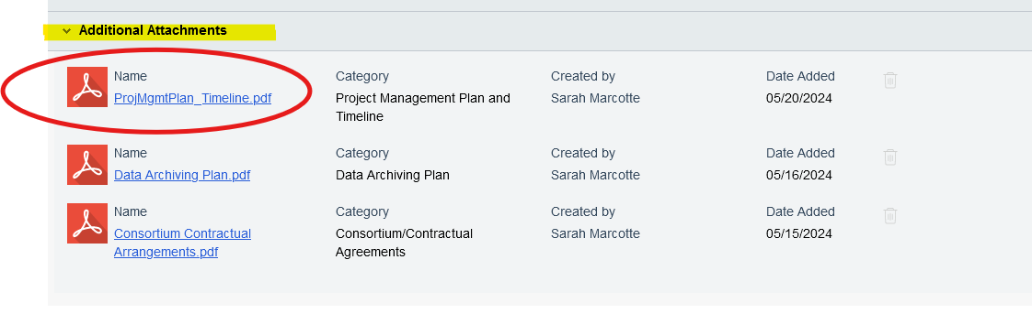
Project Management and Timeline
Timeline should include major activities AND goals, objectives, deliverables as in Proposal Narrative Section

Slide 16
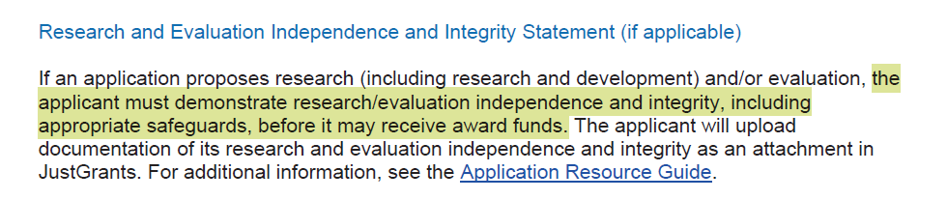
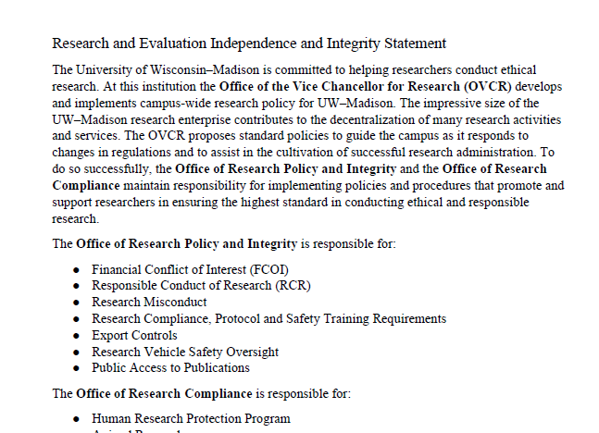
Research and Evaluation Independence and Integrity Statement
Outline institutional policies and oversight
Statement about conflicts (or lack thereof) for PI and Co-PIs

Slide 17
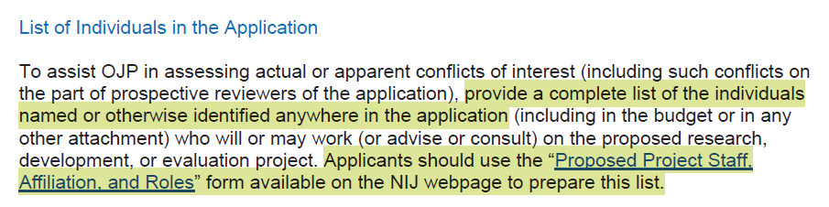
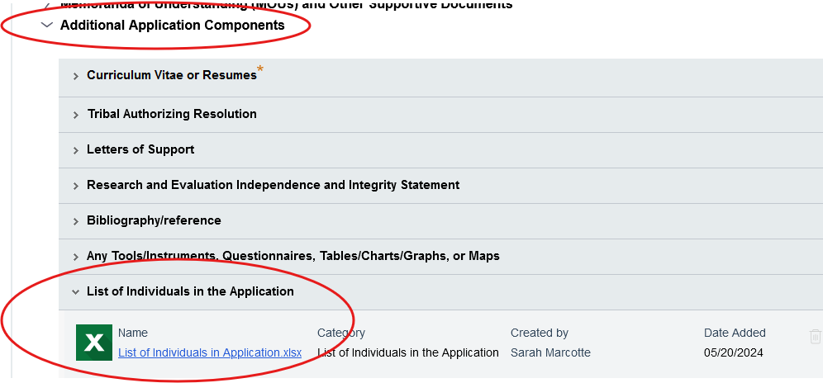
List of Individuals in the Application
Excel template on NIJ website
List of individuals involved in the project
“NIJ requests that applicants provide a list of all project staff members, contractors, consultants, and advisory board members, including their professional affiliation, and role in the proposed research project.”

Slide 18
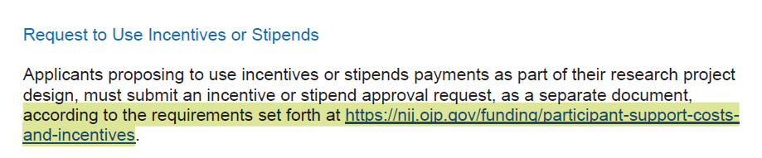
Request to Use Incentives or Stipends
What is the total amount of the stipend/incentive? Also show the breakdown by tasks if multiple payments involved (e.g., several interviews/surveys over time)? What is the age of all participants receiving stipends/incentives (in particular, if students/youths are involved)?
Explain in detail what specific form the incentives will take (please note that food, beverages, raffles, entertainment and lotteries are not allowed in any form).
Discuss how you will eliminate or minimize the appearance of coercion rather than voluntary participation for study subjects.
Provide justification demonstrating that the amount of compensation is reasonable/nominal.
What specific evidence leads you to believe that participation is unlikely without incentives?
What is the estimated impact if incentives were not used?
How will incentives be distributed and tracked?

Slide 19
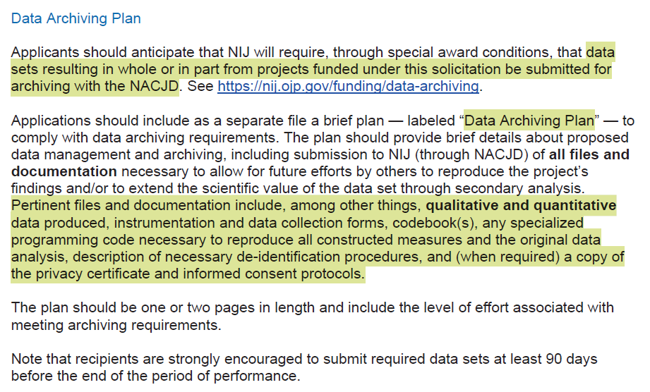
Data Archiving Plan
Two (2) page attachment
Refer to NACJD policy for requirements

Slide 20
Budget and Budget Justification
Check NOFO: Budget as uploaded file or enter onto web form
For uploaded file, may or may not be directed to use a template
For web form entry… preparation is key!

Slide 21
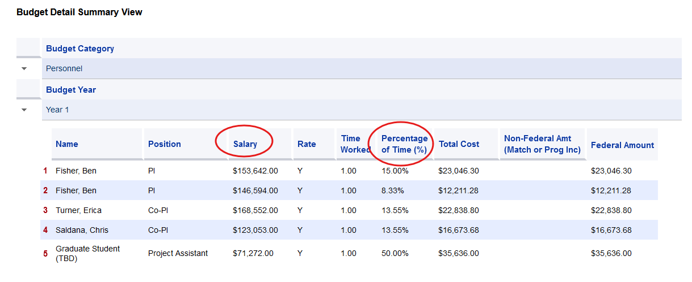
Budget Entry: Personnel
Notes:
Use annualized salary and efforts; so, must pro-rate 9-month rates and explain that in the justification.

Slide 22
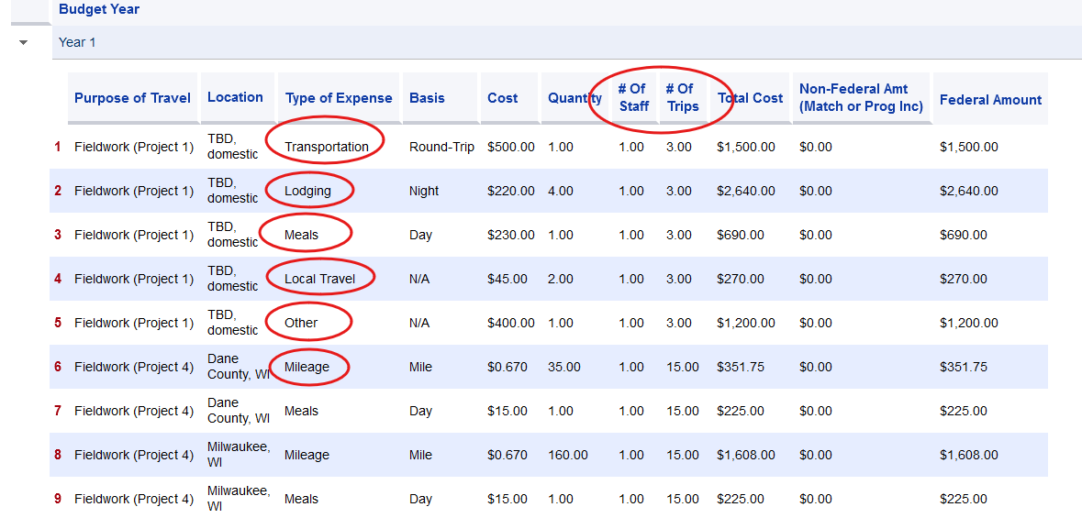
Budget Entry: Travel
Notes:
Lots of travel details required as columns show.

Slide 23
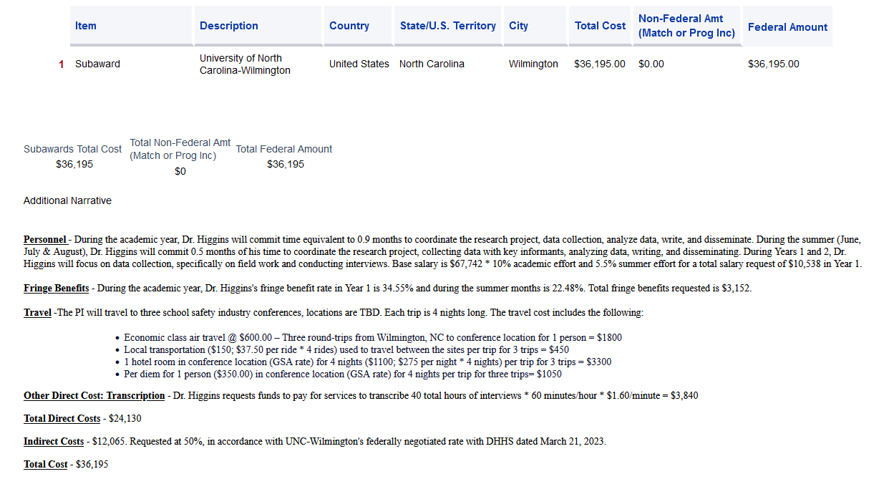
Budget Entry: Budget Justification
Notes:
Recommend you create this in Word, make all final edits, then copy into the web form.
Must have justification for costs in each year.

Slide 24
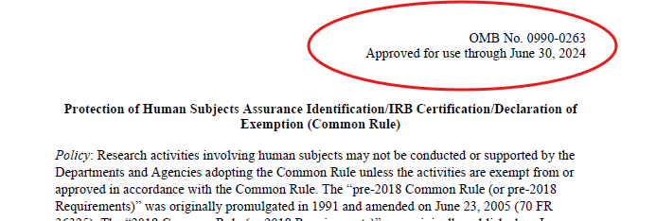
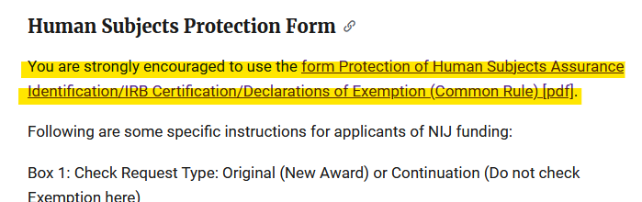
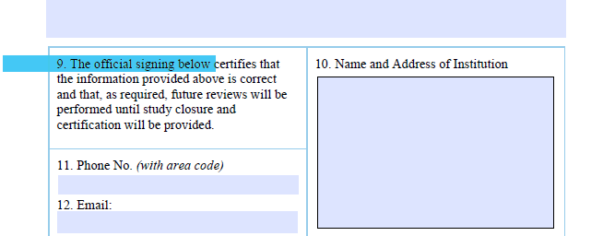
Human Subjects IRB Assurance
Human Subjects Protection Form is signed by Nadine Connor – not by Brenda Egan or RSP.
Email to compliance@research.wisc.edu
Allow 3-5 days for Office of Compliance signature.
Notes:
Human Subjects Protection Form must be signed by Nadine Connor (or another IRB representative). Brenda Egan/RSP does NOT sign this form!
Email to: compliance@research.wisc.edu
Allow 3-5 days to get the form signed.

Slide 25
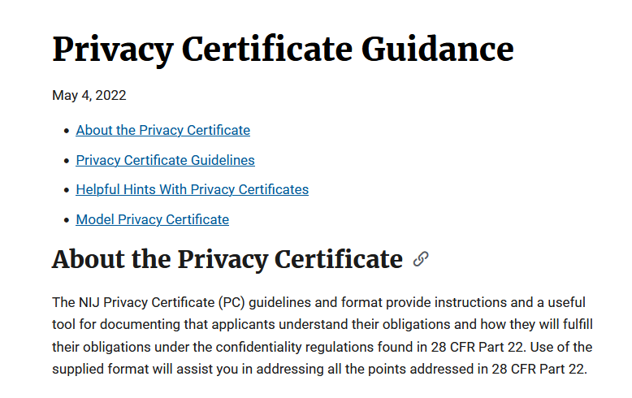
Privacy Certification
Privacy Certificate
  Not required at time of proposal
  Often is a JIT document, requiring discussion between PI and PO
  RSP can sign if no personally identifiable info (PII) will be used in the project
  If any PII will be used in the project, Office of Compliance must sign
  REVIEW NOFO
Notes:
PII = Personally Identifiable Information
TERMS & CONDITIONS can be added during negotiation periods, please be aware and read all revised documents. - share experiences

Slide 26
Progress (Performance) Reporting
Grant award administrator is the only person who can "submit". Submission = Status Changed to Pending-Review
PI requests "Alternate Grants Award Administrator" role from RSP (Darlene Holte)
PI goes in and completes
PI assigns completed PR (Performance Report) to the DOJ "GrantManager" listed within the portal application (listed in MANY places).
Delinquent reports may result in a suspension of grant funds FOR THE ENTIRE UNIVERSITY. Once the delinquent report is submitted, the suspension will be lifted within 24 hours.
Final reports are due no later than 120 days after the end of the award.
Notes:
The alternate grants administrator role to the PI ONLY is for the application in question

Slide 27
Progress Reporting
PI requests "Alternate Grants Award Administrator" role from RSP
PI goes in and completes
ROLE FOR THIS PROJECT
One and done – once RSP approves role it does not need to be requested again for subsequent reports.
Notes:
Suspension of funds for entire university
If another PI does not complete report, it will hold up other PI's funding

Slide 28
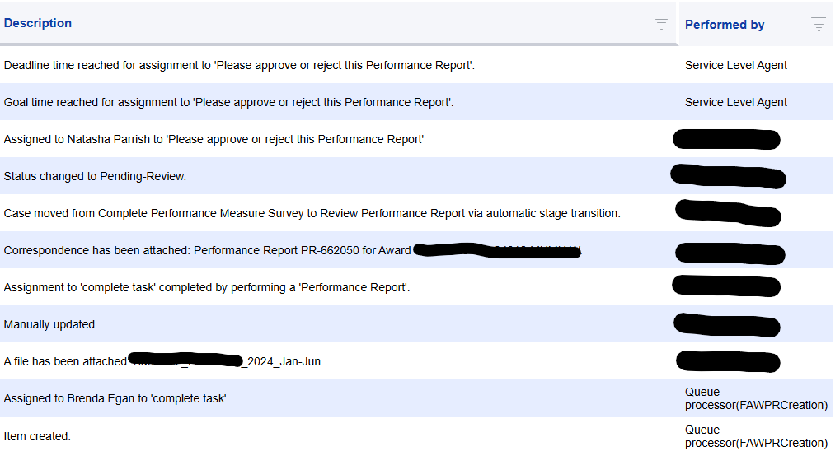
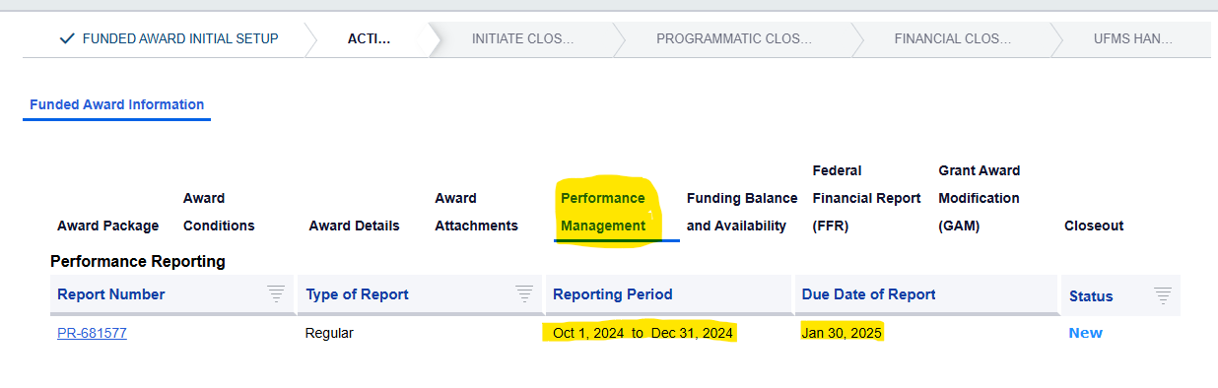
Progress (Performance) Reporting Continued
Example of what a new report will look like in the JustGrants Application.
This is all done by the PI
NOTE: "Begin" will always appear if the award is not in edit mode, however, it may not be accessible if the PR is not assigned to the logged-in user, and therefore is not available for editing.

Slide 29
Resources
Box folder with templates
  Proposal checklist; Goals, Objectives and Deliverables template; Research and Evaluation Independence Integrity Statement; Timeline template
RSP Guidance Document for JustGrants submissions
Office of Justice Programs (OJP) Application Resource Guide
https://www.ojp.gov/funding/apply/ojp-grant-application-resource-guide
Department of Justice (DOJ) Grants Financial Guide
https://www.ojp.gov/funding/financialguidedoj/overview
JustGrants YouTube Channel https://www.youtube.com/playlist?list=PLx69PAkw8NuL9MRKIb8aIF20OH5TfZJge
Notes:
We will share the Box folder with everyone

